Slide 1
Object-Oriented and
Classical Software Engineering
Fifth Edition, WCB/McGraw-Hill, 2002
Stephen R. Schach srs@vuse.vanderbilt.edu

Slide 2
CHAPTER 16
MAINTENANCE PHASE

Slide 3
Overview
Why maintenance is necessary
What is required of maintenance programmers
Maintenance case study
Management of maintenance
Maintenance of object-oriented software
Maintenance skills versus development skills
Reverse engineering
Testing during the maintenance phase
CASE tools for the maintenance phase
Metrics for the maintenance phase
Challenges of the maintenance phase

Slide 4
Maintenance Phase
Maintenance
  Any change to any component of the product (including documentation) after it has passed the acceptance test
This is a short chapter
But the whole course is on maintenance
Why is maintenance necessary?

Slide 5
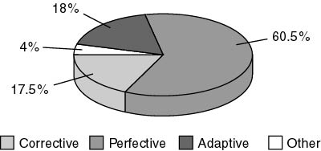
Types of maintenance

Slide 6
Types of maintenance (contd)
Corrective maintenance
  To correct residual faults
    Specification, design, implementation, documentation, or any other types of faults
  On average, 17.5% of maintenance

Slide 7
Types of maintenance (contd)
Perfective maintenance
  Client requests changes to improve product effectiveness
    Add additional functionality
    Make product run faster
    Improve maintainability
  On average, 60.5% of maintenance

Slide 8
Types of maintenance (contd)
Adaptive maintenance
  Responses to changes in environment in which product operates
    Product ported to new compiler, operating system, and/or hardware
    Change to tax code
    9-digit ZIP codes
  On average, 18% of maintenance

Slide 9
Difficulty of Maintenance
About 67% of the total cost of a product accrues during the maintenance phase
Maintenance is a major income source
Nevertheless, even today many organizations assign maintenance to
  Unsupervised beginners, and
  Less competent programmers

Slide 10
What is Required of Maintenance Programmers?
Maintenance is one of the most difficult aspects of software production because
  Maintenance incorporates aspects of all other phases
Suppose a fault report is handed to a maintenance programmer
What tools does the maintenance programmer have to find the fault?
  The fault report filed by user
  The source code
  And often nothing else

Slide 11
What is Required of Maintenance Programmers?
Maintenance programmer must have superb debugging skills
  The fault could lie anywhere within the product
  The original cause of the fault might lie in the by now non-existent specifications or design documents

Slide 12
Corrective Maintenance
Suppose that the maintenance programmer has located the fault
Problem
  How to fix it without introducing a regression fault

Slide 13
Corrective Maintenance (contd)
How to minimize regression faults
  Consult the detailed documentation for product as a whole
  Consult the detailed documentation for each individual module
What usually happens
  There is no documentation at all, or
  The documentation is incomplete, or
  The documentation is faulty
The programmer must deduce from the source code itself all the information needed to avoid introducing a regression fault

Slide 14
Corrective Maintenance (contd)
Now the programmer changes the source code
Test that the modification works correctly
  Use specially constructed test cases
Check for regression faults
  Use stored test data
Add specially constructed test cases to stored test data for future regression testing
Document all changes

Slide 15
Corrective Maintenance (contd)
Major skills required for corrective maintenance
  Superb diagnostic skills
  Superb testing skills
  Superb documentation skills

Slide 16
Adaptive and Perfective Maintenance
The maintenance programmer must go through the phases of
  Requirements
  Specifications
  Design
  Implementation and integration
Using the existing product as a starting point

Slide 17
Adaptive and Perfective Maintenance (contd)
When programs are developed
  Specifications are produced by specification experts
  Designs are produced by design experts
  Implementation is performed by implementation experts
  Integration is performed by integration experts
  Testing is performed by testing experts
  Documentation is produced by documentation experts

Slide 18
Adaptive and Perfective Maintenance (contd)
But every maintenance programmer needs to be an expert in
  Specifications
  Design
  Implementation
  Integration
  Testing
  Documentation

Slide 19
Adaptive and Perfective Maintenance (contd)
Conclusion
No form of maintenance
  Is a task for an unsupervised beginner, or
  Should be done by a less skilled computer professional

Slide 20
The Rewards of Maintenance
Maintenance is a thankless task in every way
  Maintainers deal with dissatisfied users
  If the user were happy,the product would not need maintenance
  The user’s problems are often caused by the individuals who developed the product, not the maintainer
  The code itself may be badly written
  Maintenance is despised by many software developers
  Unless good maintenance service is provided, the client will take future development business elsewhere
  Maintenance is the most important phase of software production, the most difficult—and most thankless

Slide 21
The Rewards of Maintenance (contd)
How can this situation be changed?
Managers must assign maintenance to their best programmers, and
Pay them accordingly

Slide 22
Maintenance Case Study
Temperate Fruit Committee
Software was developed for exactly 7 temperate fruits
  Apples, apricots, cherries, nectarines, peaches, pears, and plums
It was extended to include kiwi fruit, with difficulty
The product now needed to handle 26 additional fruits
“Just to the same thing 26 times”

Slide 23
Maintenance Case Study (contd)
Lessons to be learnt from this
  The problem was caused by the developer, not the maintainer
  A maintainer is often responsible for fixing other people’s mistakes
  The client frequently does not understand that maintenance can be difficult, or all but impossible
  This is exacerbated when previous apparently similar perfective and adaptive maintenance tasks have been carried out
  All software development activities must be performed with an eye on future maintenance

Slide 24
Management of Maintenance
We need a mechanism for changing a product
If the product appears to function incorrectly, the user files a fault report
  It must include enough information to enable the maintenance programmer to recreate the problem
Ideally, every fault should be fixed immediately
  In practice, immediate preliminary investigation

Slide 25
Management of Maintenance (contd)
The maintenance programmer should first consult the fault report file
All reported faults not yet fixed, and
Suggestions for working around them

Slide 26
Management of Maintenance (contd)
Previously reported fault
Give information in fault report file to user

Slide 27
Management of Maintenance (contd)
New fault
Maintenance programmer should try to find
  Cause of fault
  A way to fix it
  A way to work around problem
New fault is now filed in the fault report file, together with supporting documentation
  Listings
  Designs
  Manuals

Slide 28
Management of Maintenance (contd)
The file should also contain the client’s requests for perfective and adaptive maintenance
  Contents of file must be prioritized by the client
  The next modification is the one with the highest priority
Copies of fault reports must be circulated to all users
  Including: estimate of when the fault can be fixed
If the same failure occurs at another site, the user can determine
  If it is possible to work around the fault, and
  How long until it can be fixed

Slide 29
Management of Maintenance (contd)
In an ideal world
  We fix every fault immediately
  Then we distribute the new version of product to all sites
In the real world
  We distribute fault reports to all sites
  We do not have the staff for instant maintenance

Slide 30
Making Changes to the Product
Corrective maintenance
  Assign a maintenance programmer to determine the fault and its cause, then repair it
  Test the fix, test the product as a whole (regression testing)
  Update the documentation to reflect the changes made
  Update the prologue comments to reflect
    What was changed,
    Why it was changed,
    By whom, and
    When

Slide 31
Making Changes to the Product (contd)
Adaptive and perfective maintenance
  As with corrective maintenance, except there is no fault report
  There is a change in requirements instead

Slide 32
Making Changes to the Product (contd)
What if the programmer has not tested the fix adequately?
  Before the product is distributed, it must be tested by the SQA group
Maintenance is extremely hard
Testing is difficult and time consuming
Baselines and private copies

Slide 33
Ensuring Maintainability
Maintenance is not a one-time effort
We must plan for maintenance over the entire life cycle
  Design phase—use information-hiding techniques
  Implementation phase—select variable names meaningful to future maintenance programmers
  Documentation must be complete and correct, and reflect current version of every module

Slide 34
Ensuring Maintainability (contd)
During the maintenance phase, maintainability must not be compromised
  Always be conscious of the inevitable further maintenance
Principles leading to maintainability are equally applicable to the maintenance phase itself

Slide 35
The Problem of Repeated Maintenance
Moving target problem
  Frustrating to development team
  Frequent changes have an adverse effect on the product
Apparent solution
  Construct a rapid prototype
  Change it as frequently as the client wants
  Once the client is finally satisfied, the specifications are approved and product is constructed
In practice
  The client can change the requirements next day
  If willing to pay the price, the client can change the requirements daily

Slide 36
Problem of Repeated Maintenance (contd)
The problem exacerbated during the maintenance phase
The more changes there are
  The more the product deviates from its original design
  The more difficult further changes become
  Documentation becomes even less reliable than usual
  Regression testing files are not up to date
  A total rewrite may be needed for further maintenance

Slide 37
Moving Target Problem (contd)
Clearly a management problem
In theory
  Developers must explain the problem at start of the project
  Specifications can be frozen until delivery
  Specifications can be frozen after perfective maintenance
In practice
  It does not work that way
  A client with clout can order changes and they are implemented
“He who pays the piper calls the tune”

Slide 38
Warning
It is no use implementing changes slowly
The relevant personnel are replaced
Nothing can be done if the person calling for repeated change has sufficient clout

Slide 39
Maintenance of Object-Oriented Software
The object-oriented paradigm promotes maintenance
  The product consists of independent units
  Encapsulation (conceptual independence)
  Information hiding (physical independence)
  Message-passing is the sole communication
Reality is somewhat different!
Three obstacles
  The complete inheritance hierarchy can be large
  The consequences of polymorphism and dynamic binding
  The consequences of inheritance

Slide 40
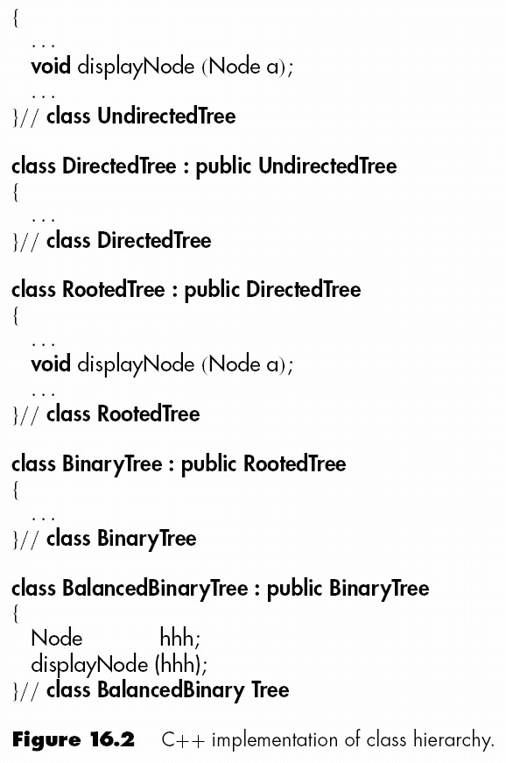
Size of Inheritance Hierarchy

Slide 41
Size of Inheritance Hierarchy (contd)
To find out what displayNode does in BalancedBinaryTree, we must scan the entire tree
  Inheritance tree may be spread over the entire product
  A far cry from “independent units”
Solution
  A CASE tool can flatten the inheritance tree
  Eiffel flat

Slide 42
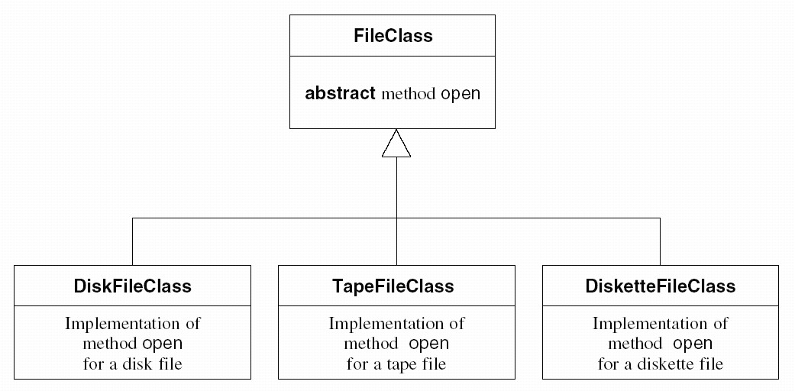
Polymorphism and Dynamic Binding
Product fails on the invocation myFile.open ()
Which version of open contains the fault?
  A CASE tool cannot help (static tool)
  We must trace

Slide 43
Polymorphism and Dynamic Binding (contd)
Polymorphism and dynamic binding can have
  Positive effect on development
  Negative effect on maintenance

Slide 44
Consequences of inheritance
Create new subclass by inheritance
  Does not affect superclass
  Does not affect any other subclass
Modify this new subclass
  Again, no affect
Modify a superclass
  All descendent subclasses are affected
Inheritance can have
  Positive effect on development
  Negative effect on maintenance

Slide 45
Maintenance versus Development Skills
Skills needed for maintenance include
  Ability to determine cause of failure of large product
    Also needed during integration and product testing
  Ability to function effectively without adequate documentation
    Documentation rarely complete until delivery
Skills in specification, design, implementation, testing
  All four activities carried out during development
Skills needed for maintenance same as those for other phases

Slide 46
Maintenance versus Development Skills
Key Point
  Maintenance programmers must not merely be skilled in broad variety of areas, they must be highly skilled in all those areas
  Specialization impossible for the maintenance programmer
Maintenance is the same as development, only more so

Slide 47
Reverse Engineering
When the only documentation is the code itself
  Start with the code
  Recreate the design
  Recreate the specifications (extremely hard)
  CASE tools help (flowcharters, other visual aids)

Slide 48
Reverse Engineering (contd)
Definitions
  Reengineering
    Reverse engineering, followed by forward engineering
    Lower to higher to lower levels of abstraction
  Restructuring
    Improving product without changing functionality
    Prettyprinting, structuring code, improving maintainability

Slide 49
Reverse Engineering
What if we have only the executable code?
  Treat as black box

Slide 50
Testing during the Maintenance Phase
Maintainers view a product as loosely related modules
  They were not involved in development of the product
Regression testing is essential
  Store test cases and outcomes, modify as needed

Slide 51
CASE Tools for the Maintenance Phase
Version, revision control tools
Reengineering tools
  Battlemap, Teamwork, Bachman Product Set

Slide 52
Metrics for the Maintenance Phase
Metrics for development phases
Fault report metrics

Slide 53
Challenges of the Maintenance Phase
The development-then-maintenance model is unrealistic today
  The client’s requirements frequently change before the product is delivered
  Faults often have to be fixed before the product is delivered
  Development from scratch is almost unknown today.
    Instead, products are built from reused components.
Products are modified before delivery

Slide 54
Future of Software Engineering
Must people have 20-20 hindsight
  Forecasting the future is much harder!
Possible scenario 1
  Emphasis on formal techniques
  Formal object-oriented techniques
Possible scenario 2
  Intensive reuse of hundreds of standard classes
Possible scenario 3
  Totally different to anything currently envisioned

